Slide 1
GSE Loan Level Credit Modifications
April 2015

Slide 2
Modifications are Modeled Indirectly
Modifications in the GSE Loan Level data are a very small percentage of total Balance
~0.015% since 2011
Modifications in the GSE Loan Level data are not always identified
Flag for modification doesn’t always correspond what we see in the data: Rate Reductions, Term Reductions or Balance Liquidations
With these 2 points in mind, we have chosen (at least for the first iteration) to not model Modifications directly as a separate transition status: Current, 30, 60, 90+, Mod, Out
The transition rates from all Delinquent Status (30, 60, 90+), back to Current are modeled
The results of these “Cure” transitions can be viewed historically to test for goodness of fit
Defining any of these “Cure” transitions as Modifications is arbitrary, and does not effect the results of the Model Projections
If later we want to model Modifications as a separate Transition Status, we should be aware that the complexity of the model will increase and due to the lack of modification data, it could be difficult to specify these transitions with great accuracy
Ex) 60 -> Mod; Mod -> 30; Mod -> Current; etc

Slide 3
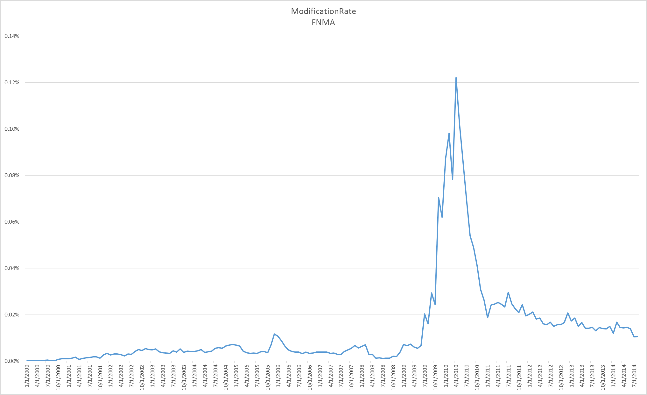
Modification Rate as Reported by FNMA

Slide 4
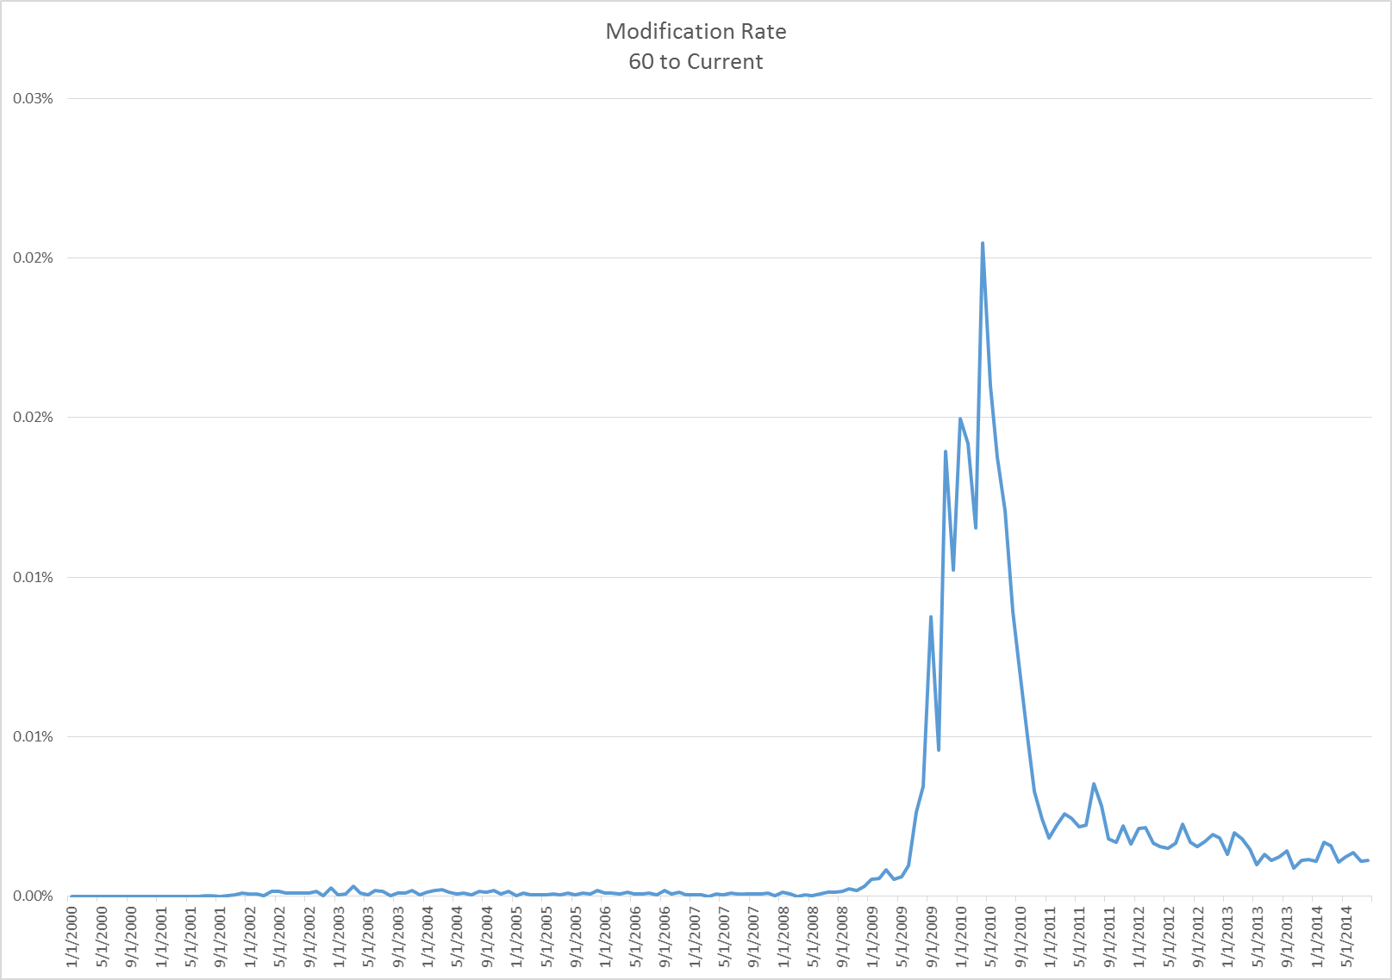
Modification Rate as Reported by FNMA (60 Days DQ)

Slide 5
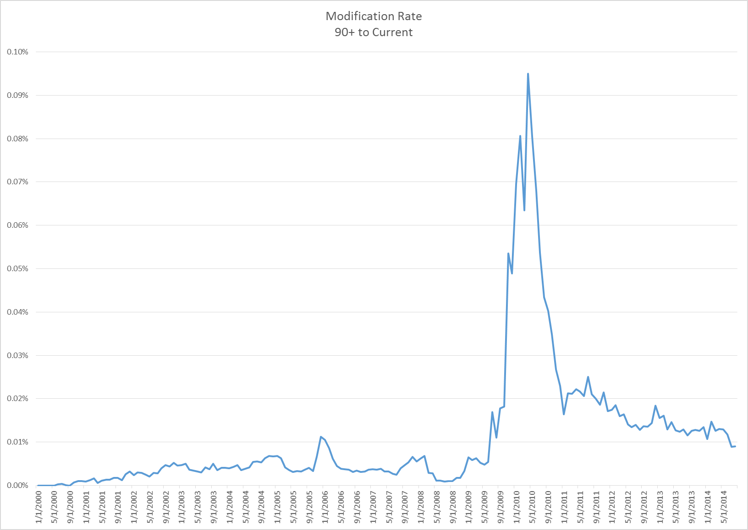
Modification Rate as Reported by FNMA (90+ Days DQ)

Slide 6
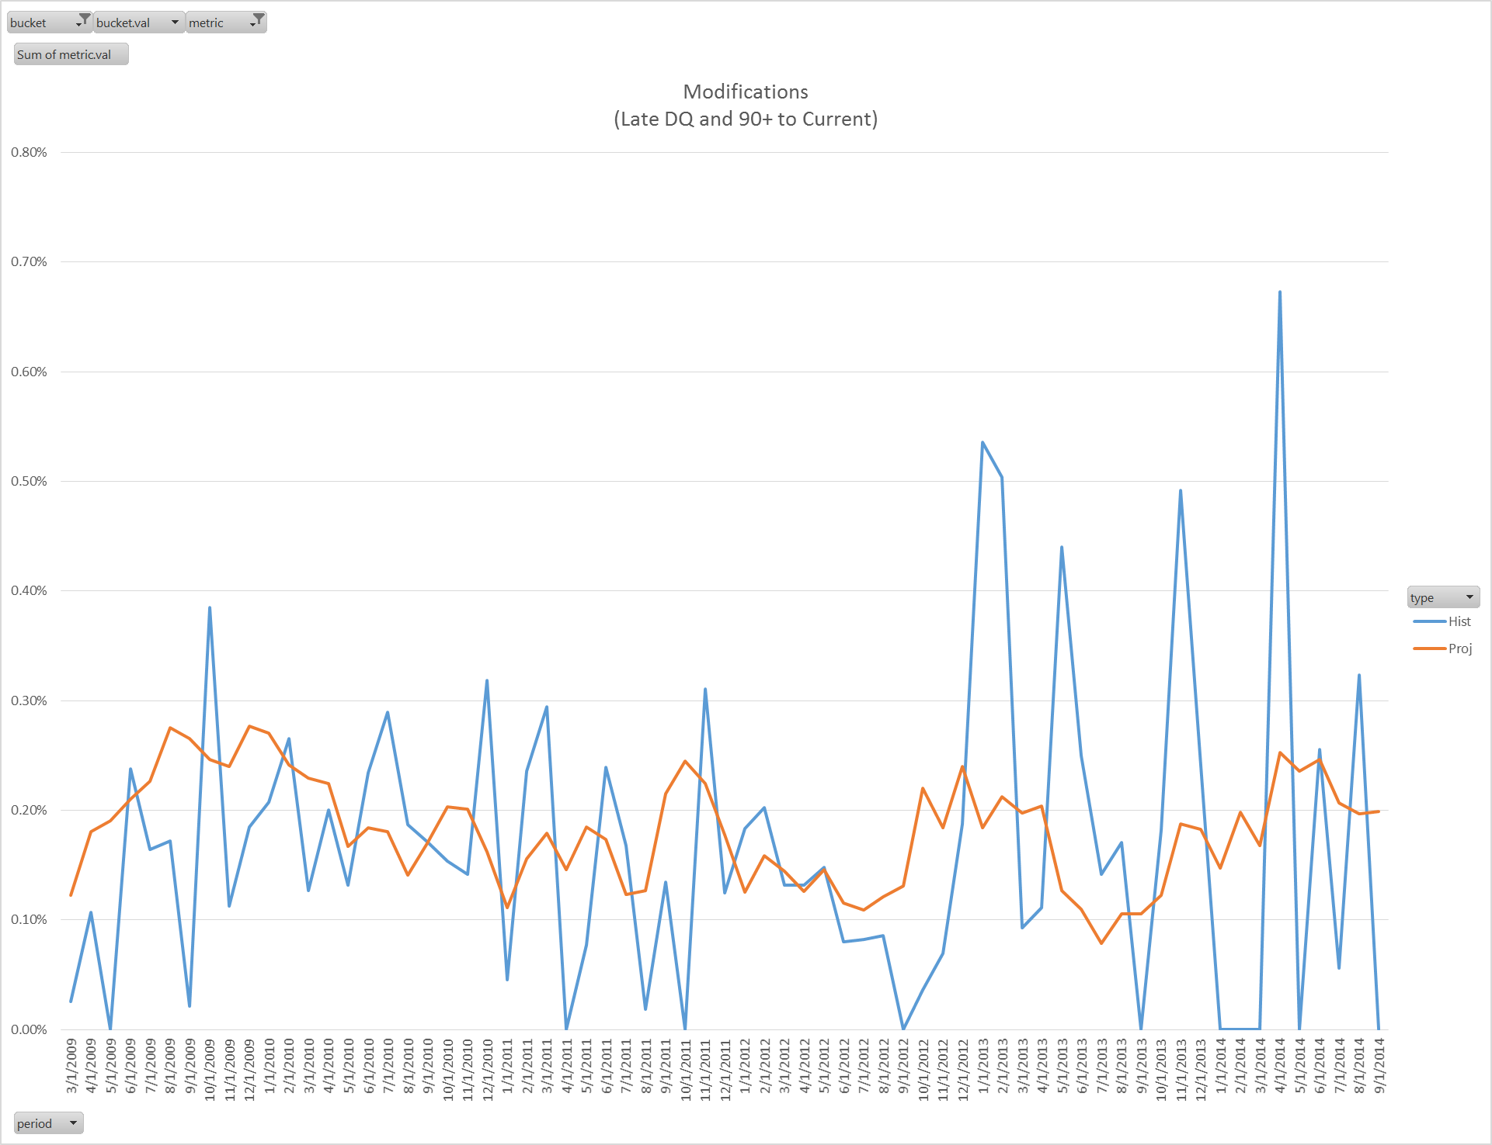
Model Fit: Mods = Cures (Late DQ or 90+ to Current)

Slide 7
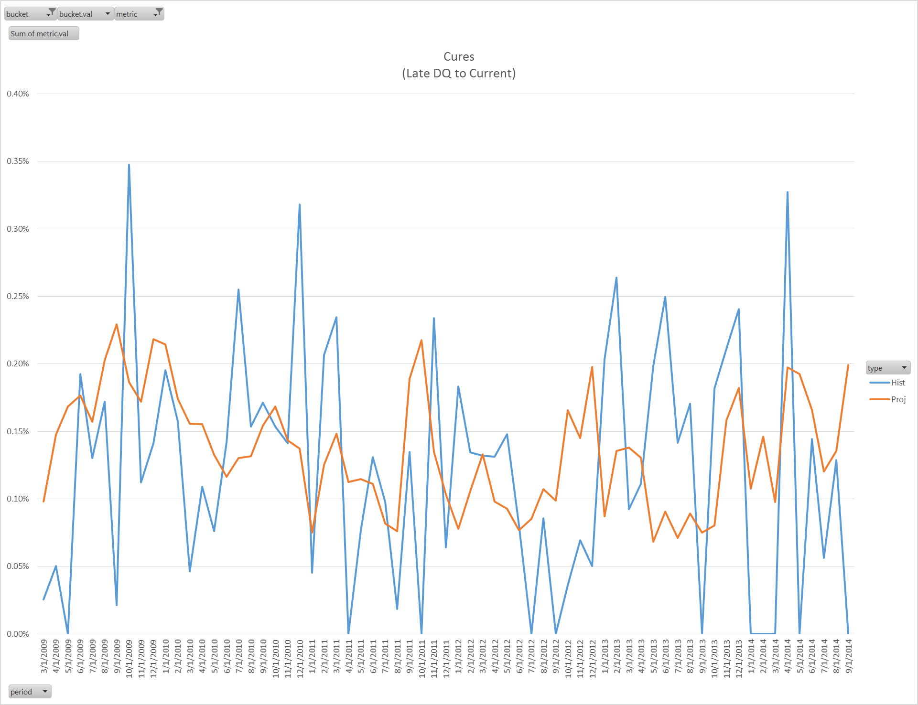
Model Fit: Mods = Cures (Late DQ to Current)

Slide 8
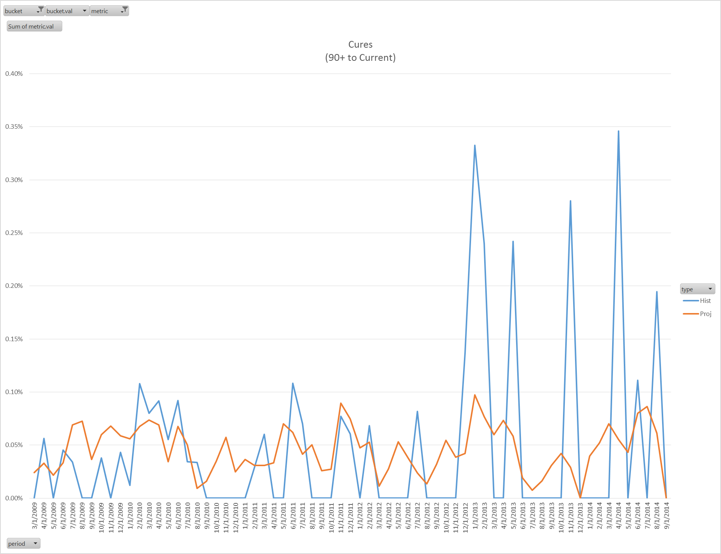
Model Fit: Mods = Cures (90+ to Current)

